Slide 1
Text Annotation
A Close Reading Strategy for Better Comprehension

Slide 2
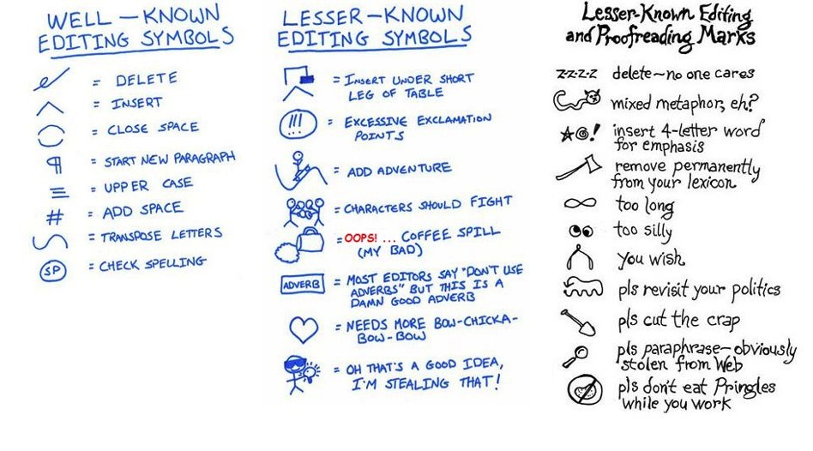
Text Annotation by Teachers
Notes:
These are editing symbols. In text annotation, students may elect to use symbols or tiny drawings, in addition to underlining, bracketing, circling, or writing comments or questions,

Slide 3

What is Text Annotation?
While reading, students mark the pages for
Important information
Text meaning or key details
Ideas and questions
Notes:
Some readers mark the text extensively; some readers only mark the parts they think are important or problematic. It’s not essential how MUCH students annotate, only that they DO annotate. The act of marking the page while reading makes it more likely that students will read closely and attentively.

Slide 4

What About Highlighters?
Students often think text annotation simply involves highlighting almost every word in a text.
Notes:
It’s important to note that highlighting may be part of student’s system for annotation but it is NOT effective if it’s the only system.

Slide 5

What About Highlighting?
Harvard University puts incoming students on notice about the effectiveness of highlighting…
Notes:
This comes from Harvard University Advice to Incoming Students.

Slide 6
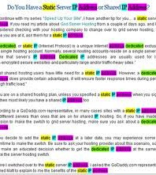
Highlighting Dilutes Comprehension
“First of all, throw away the highlighter in favor of a pen or pencil.
Highlighting can actually distract you from the business of learning
and dilute your comprehension”(2005).
Notes:
Please point out how distracting and complicated this seems. Also, if the reader doesn’t remember the color code, this could be meaningless later.

Slide 7
Improves Comprehension
Note-taking activities have a positive impact on reading comprehension
Twenty-one of twenty-three studies (91%) showed a positive outcome
Notes:
From Writing to Read—annotation is considered a note-taking strategy, something students must learn to do—and something that is taught infrequently in school.

Slide 8
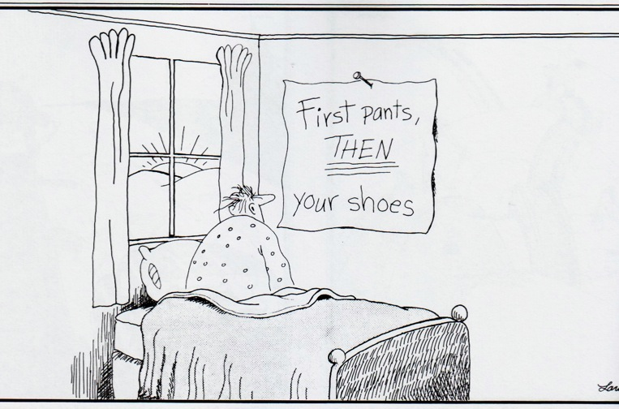
Teaching different annotation styles helps students discover what works for them.
It’s important to expose them to different ways to annotate texts while they read. Over time, the students will gravitate to those that fit their individual needs best. However, they need to learn that there are MANY styles and strategies.
Notes:
Teachers need to both teach annotation explicitly and teach multiple annotation styles. One reason students resort to only using highlighters is that they don’t know any other to note important information while they read.

Slide 9
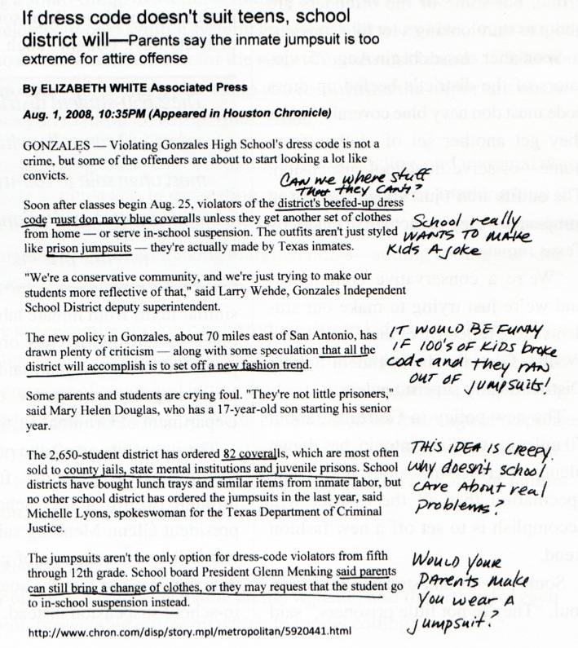
Annotation Styles and Strategies
Bracket [important] passages
Notes:
The following seven slides illustrate multiple annotation styles. Move quickly through these as they are fairly self-explanatory. All of the annotation styles can be used at the same time by students while they read, depending on the purpose and comprehension level of the reader. Bracketing works for larger sections of text (like quotes, lines from other works, text within text). Labeling by the the brackets helps identify why the bracketed text is important.

Slide 10
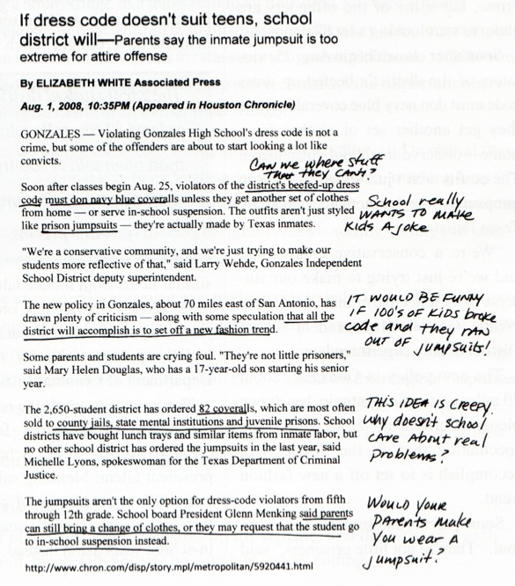
Annotation Styles and Strategies
Connect related ideas with lines
Underline important ideas/details
Notes:
Underlining important and key ideas allows readers to find essential information without having to reread the entire text. When sections of text are connected, drawing lines or arrows between connecting ideas allows the reader to “see” those connections without having to reread the entire text. It also helps readers make critical text-to-text connections while they read.

Slide 11
Annotation Styles and Strategies
Outline main ideas in margin
and/or
Write margin notes (comments and questions)
Notes:
Margin notes are essential and can include comments, questions, and symbols that the reader understands. By both reading AND writing while reading, comprehension is improved.

Slide 12

Annotation Styles and Strategies
Pneumonoultramicroscopicsilicovolcanoconiosis
Circle unfamiliar vocabulary
Notes:
This is a real word. It’s a disease of the lungs caused by inhaling small particles of dust from a volcanic eruption. Circling unfamiliar words (and sometimes looking them up in a dictionary or glossary) if there are no context clues within the reading, helps the reader know what questions to ask about the reading to improve his/her comprehension. It’s also a step frequently ignored by poor readers who skip over unfamiliar words and who never review them, even when reading in context doesn’t work.

Slide 13
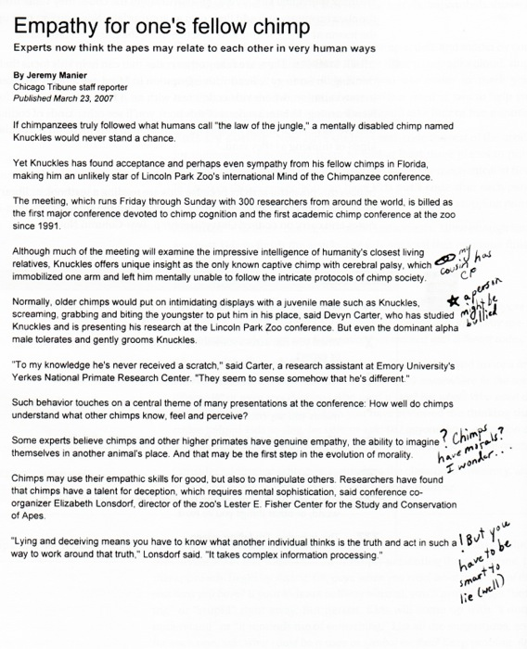
Annotation Styles and Strategies
Place asterisks or exclamation points next to unusual or surprising details
****
Notes:
Using asterisks or exclamation points next to unusual or surprising details allows readers to attend to the details and then move on to the more important or key details in the reading.

Slide 14
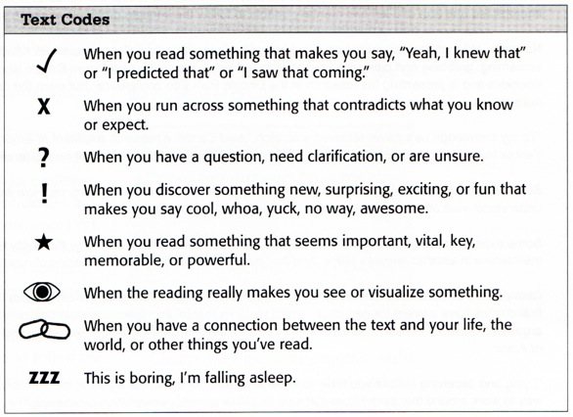
Annotation Styles and Strategies
Use symbols, drawings, and small drawings(text coding) to highlight important details
When using text coding, consistency is important. Students need to understand the key.
Notes:
If students are using text codes, emphasize that there needs to be some consistency in the coding so that students remember what the symbols mean.

Slide 15

Annotation Styles and Strategies
Can’t write in books?
Label with sticky notes—Students can use all the same strategies by placing their annotations on sticky notes on the pages of their books.
Copy important sections from text (doesn’t break copyright if used for educational purposes)
Notes:
This strategy works best with limited amounts of text. It can also be cost prohibitive because someone has to buy the sticky notes.

Slide 16

Reading With Your Pen Palette
The Reading With Your Pen Palette was developed by three teachers in Bronx, NY.
There are 21 different annotation strategies students can use to annotate or code text while they read.
Notes:
Please refer teachers to the “Reading With Your Pen” Palette handout. They will use this to complete practice assignment.

Slide 17
Learning Annotation Styles
Model this close reading strategy with students before assigning individual reading.
Students are individually assigned a text to read.
DO NOT review the text with students other than to introduce the topic to be read or to set the purpose for reading.
Students use the “Reading Pen” palette to annotate text while reading.
Notes:
Text can be broadly defined—this could be a few paragraphs, a section in a textbook, a chapter, or an article. The reason teachers SHOULD NOT review the text prior to reading is that it defeats the purpose for reading. If we always tell students what they will be reading or review ad nauseum after they’ve read by going over every detail, students learn NOT to read because they learn the teacher will TELL them what they need to learn.

Slide 18
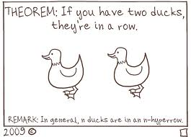
Learning Annotation Styles
After reading, students can discuss, review, analyze, evaluate, critique, be quizzed or tested on the material.
The more students practice using annotation, the more automatic and precise they become as critical readers.
Eventually, students become more competent readers if they write while they read.
Notes:
After teachers have completed their 10 minute practice with annotation, briefly discuss what they saw as challenging. Ask for teaching tips.

Slide 19
Practice Makes Perfect
Quickly review the annotation styles on the Reading With Your Pen Palette. As you review the list, select five of the annotation strategies you find most useful.
Using the Reading With Your Pen Palette read and annotate the assigned article using the five strategies you selected from the handout. You may use them over and over or use each once.
While you read, number your annotations.
Please read and annotate the entire article.

Slide 20
Practice Makes Perfect
After completing the reading, turn to your left and discuss two important details you learned from the article.
With your partner, discuss the annotation strategies you selected.
Reflect on the process—did annotating the article improve or impede your comprehension? How would you use annotation to improve reading and writing in your content area?

Slide 21
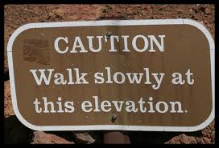
Challenges and Tips
Annotation slows down reading but increases comprehension.
Good readers don’t believe it works or don’t think it’s necessary.
Demonstrate what they don’t remember by using a short, detailed quiz
Notes:
Have students read short, complicated material without requiring any annotation. Don’t allow students to refer to the text during the quiz. After the quiz, see what details students forgot. Use this as the basis for your discussion about the necessity of writing while reading. After students complete a reading assignment with required annotations, evaluate if they did better. Allow them to use their annotated texts on tests, etc. Students discover that annotations allow them to find essential information quickly.

Slide 22
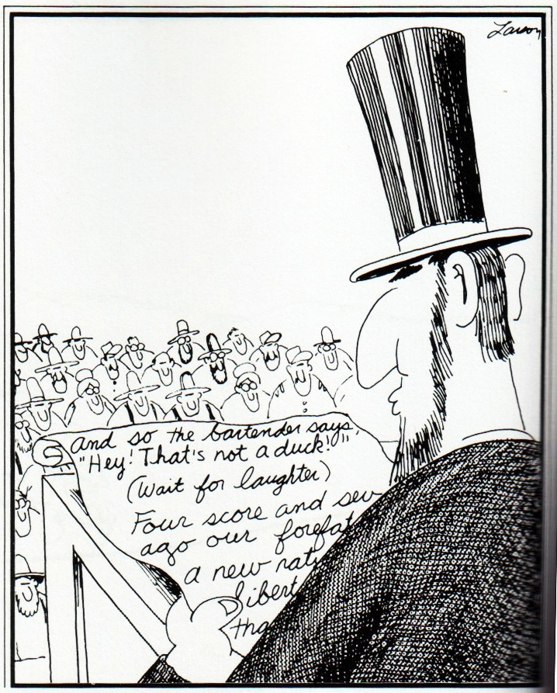
Notes:
Annotation is often seen in scripts as stage direction.

Slide 23
Challenges and Tips
Struggling readers won’t do it.
Don’t require students to read and annotate huge sections of text.
Differentiate the amount of text or the number or annotations for readers based on ability.
Notes:
All students should be held equally accountable for completing reading with annotations. Struggling readers need to learn how to monitor their own comprehension and annotating text helps them do this.

Slide 24
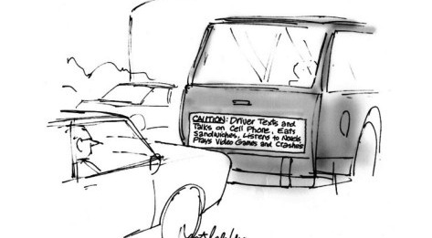
Challenges and Tips
Notes:
Annotation requires concentration.

Slide 25

Challenges and Tips
It’s time-consuming and/or difficult to assess.
Have students number their annotations and count the quality annotations
Give completion points
Use the annotated text as the springboard for guided discussions, writing assignments, quiz/test notes

Slide 26

Challenges and Tips
Where do I find the resources?
Pioneer Library online—the lexile level (reading difficulty) is available for every article
Google—it really is your friend! Type in the topic and you will find many informational articles
Online newspaper sites
Textbooks
Notes:
There are many resources available for informational reading. These are the best.

Slide 27

Your Turn
Using your textbook or curriculum map, select a student reading text you will assign in the next 30 days. Discuss how you will use and adapt Text Annotation in your own classroom.

